Slide 1




INTELLITRACE HACKATHON 2026 finVerse - CLARITY IN EVERY TRANSACTIONS -

Slide 2
DETAILS OF TEAM
PROBLEM STATEMENT - Multi-Tier Supply Chain Fraud Detection and Management
TEAM NAME - finVerse
CATEGORY – SOFTWARE
TEAM MEMBERS - APURBA DAS
DEEPAK JAIN
NEERAK KUMAR
VANSH AHUJA
UNIVERSITY NAME - VELLORE INSTITUTE OF TECHNOLOGY , BHOPAL

Slide 3
PROBLEM STATEMENT
02
Multi-Tier Supply Chain Fraud Detection and Management
In multi-tier supply chain finance (Tier 1→Tier 2→Tier 3), a Tier 1 supplier fabricated 340 phantom invoices (~$47M). Each invoice looked legitimate individually, but cross-tier cascading triggered repeated financing, multiplying exposure. Traditional invoice checks failed because the fraud becomes visible only through network-level correlation.
WHY THIS PROBLEM MATTERS
$4 BILLION LOST ANNUALLY IN INVOICE FRAUD
PHANTOM INVOICING & DUPLICATE FINANCING
NO VISIBILITY BEYOND TIER-1 SUPPLIERS
CASCADING FINANCIAL EXPOSURE

Slide 4


LIMITATIONS OF CURRENT SYSTEMS
CURRENT APPROACH
LIMITATIONS
MANUAL INVOICE VERIFICATION
RULE-BASED FRAUD DETECTION
BANK LEVEL MONITORING
SLOW AND ERROR-PRONE
CANNOT DETECT HIDDEN NETWORK FRAUD
NO MULTI-TIRE VISIBILITY

Slide 5

INTRODUCING finVerse
finVerse is an AI powered graph based fraud detection system that analyzes multi-tier supply chain relationships in real time to detect hidden financial risks
KEY FEATURES:
Graph Intelligent engine
Real-time risk Scoring
Duplicate invoice Detection

Slide 6
PROPOSED SOLUTION
We propose a real-time fraud detection framework that evaluates invoices across multiple supply chain tiers before financing is approved. The system focuses on preventing phantom invoices, duplicate financing, over-invoicing, circular trades, and dilution fraud.
Structured Multi-Tier Data
Model the supply chain as a connected network of buyers, Tier 1, Tier 2, and Tier 3 suppliers, along with lenders. Capture POs, GRNs, invoices, payments, and relationships to enable cross-verification.
Invoice Validation
Match each invoice with its corresponding PO and GRN. Flag missing records, mismatches, and abnormal value deviations.
Cross-Lender Duplicate Detection
Generate a unique invoice fingerprint and check across lenders to prevent multiple financing of the same invoice.
Network-Based Anomaly Detection
Analyze buyer–supplier relationships to detect circular trades, unusual transaction paths, and abnormal invoice velocity.
Unified Risk Scoring
Combine all checks into a single risk score and generate alerts before disbursement.

Slide 7
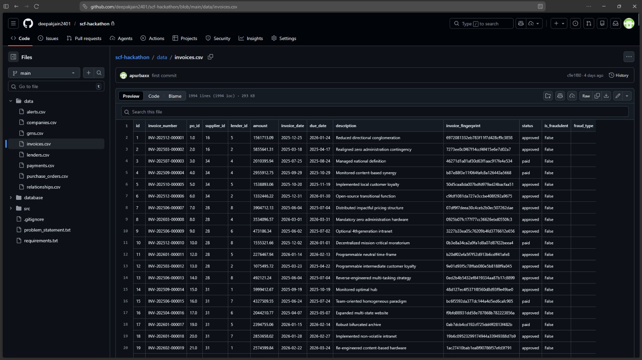

CURRENT PROTOTYPE STAGE
THE AVOVE DATA SET IS BUILT USING PYTHON

Slide 8
KEY FEATURES
Cross-lender duplicate invoice detection
PO–GR Invoice cross verification
Real-time invoice screening
automated alert generation
invoice fingerprinting
Invoice velocity and pattern monitoring

Slide 9
GITHUB REPOSITORY
https://github.com/deepakjain2401/scf-hackathon

Slide 10
THANK YOU

